Slide 1
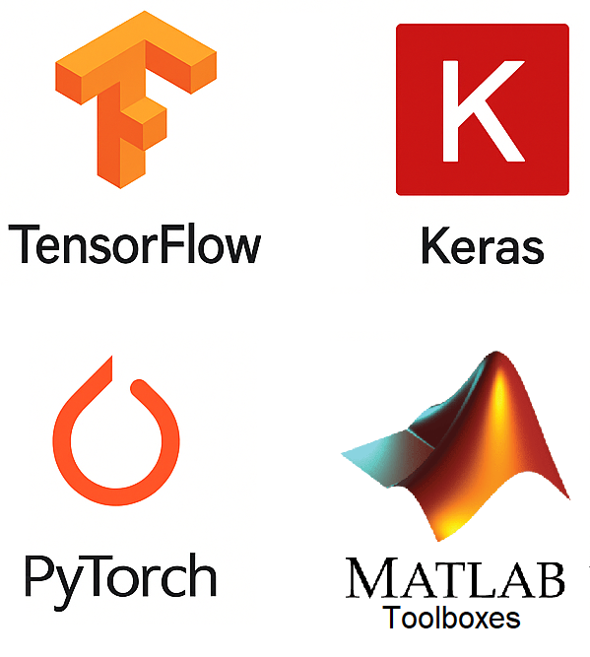
Deep Learning Frameworks
Deep learning frameworks are software libraries that make it easier to design, build, train, and deploy deep learning models, especially neural networks.
Instead of starting from scratch and writing low-level code to handle things like matrix operations or GPU acceleration, these frameworks provide ready-made tools.
They help in:
Building models layer by layer (e.g., feedforward, convolutional or recurrent)
Training models efficiently using CPUs or GPUs
Visualizing progress (e.g., accuracy and loss over time)
Saving and deploying trained models to web apps, mobile devices, or servers
Different frameworks have different strengths. Some are great for beginners, while others offer more control and flexibility for research or large-scale applications.

Slide 2
Deep Learning Frameworks
Can model Complex architectures
Not so easy to use
Quite Flexible
Easy visualization tools
Most popular in the Industry
High-Level API (it is a TF interface)
Basic architectures
Very easy to use
Limited Flexibility
Best choice for newbies
Can model Complex architectures
Not so easy to use
Very Flexible
Needs more lines of code
Most popular in Academia
Not a proper DLF
Not free
Specialized toolboxes
Quite easy to use
Limited Flexibility
PyTorch vs TensorFlow vs Keras

Slide 3
Deep Learning Frameworks
Tensorflow – Keras
Keras is API for Tensorflow:
An API (Application Programming Interface) is a set of tools that allows two pieces of software to communicate with each other.
It provides a set of easy-to-use commands (functions, classes, tools)
You don’t need to understand all the complex math or hardware underneath
You just call the functions, give them your data, and they do the work
You can see it is like a bridge that connects different programs (your Python script vs deep learning framework Tensorflow), allowing them to exchange information and functionality without having to share source code.

Slide 4
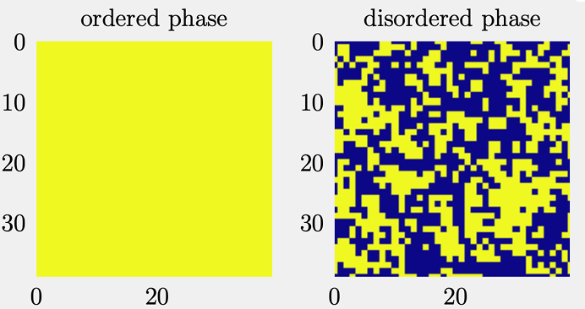




Task to be solved:
Identifying the phases of the 2D Ising model
Logistic regression as 1 Neuron network
x$_{1}$
x$_{2}$
.
.
.
.
.
.
.
x$_{n}$
$$θ_{i}$$
$$σ(θ·x+b)$$
Output
Poor performance
Can we improve? Cybenko universal approximation theorem 1989

Slide 5






Task to be solved:
Identifying the phases of the 2D Ising model
Network with 1 hidden layer
x$_{1}$
$$θ_{ij}^{1}$$
x$_{2}$
.
.
.
.
.
.
.
x$_{n}$
$$σ(θ_{1}^{1}·x+b_{11})$$
$$θ_{1}^{2}$$
$$σ(θ^{2}·a+b_{2})$$
Output
$$θ_{2}^{2}$$
$$σ(θ_{2}^{1}·x+b_{12})$$
Poor performance
Hard task to build ‘by hand’ the gradients, even for a small network – Keras can help us !!!

Slide 6
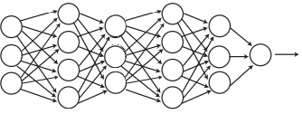
How to improve performances?
MORE LAYERS
More model expressivity
How to build gradients ‘by hand’ here?
I think impossible (in adequate times)!

Slide 7
We will
Build the three models we discussed (using Keras)
Take our first look at Google Colab (Getting started with Colab)
Run Python in notebooks
Have our first interaction with GitHub

Slide 8
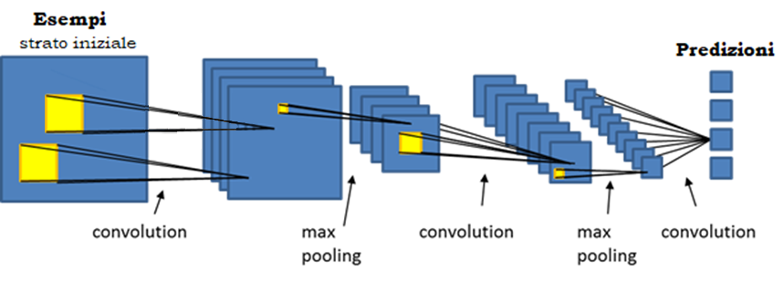
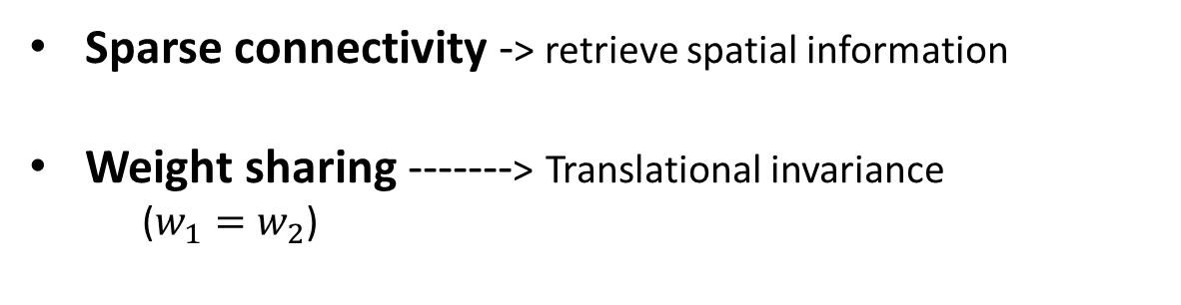


CNNs
$$w_{1}$$
$$w_{2}$$
Sparse connectivity -> retrieve spatial information
Weight sharing -------> Translational invariance
($w_{1}=w_{2}$)

